Slide 1
SharePoint Developer Roadmap
Getting Started with SharePoint 2010 Development
Notes:
Learn what's new for developers in SharePoint 2010. This module provides a good introduction to SharePoint 2010 for those with and without prior SharePoint experience. You'll learn the basics of SharePoint and how to get around including the administration story and leveraging the new PowerShell interface.

Slide 2
Agenda
Introductions
SharePoint 2010 Architecture
SharePoint Developer’s Windows PowerShell Primer
SharePoint Designer 2010

Slide 3
Student Questionnaire
What's Your Name and company?
Do you meet the class prerequisites?
Experience with Visual Studio and the .NET FX
Experience coding in either C# or VB.NET
Did you use a previous version of SharePoint?
SharePoint 2001 - STS and SPS
SharePoint 2003 - WSS2 and SPS
SharePoint 2007 - WSS3 and MOSS
What roles have you worked in?
User
Site collection administrator
Farm administrator
Developer

Slide 4
Agenda
Introductions
SharePoint 2010 Architecture
SharePoint Developer’s Windows PowerShell Primer
SharePoint Designer 2010

Slide 5
Reflecting on SharePoint 2007
Windows SharePoint Services (WSS 3.0)
At its core, a site and list provisioning engine
Recognized by SharePoint Developers as a "platform"
Microsoft Office SharePoint Server (MOSS)
Built on top of WSS 3.0
Provides extra components and services Enterprise Search, Forms Services, WCM, ECM, BDC, etc…
The Old World
Browser Clients
Microsoft Office SharePoint Server 2007 (MOSS)
MS Word Clients
Windows SharePoint Services 3.0 (WSS v3)
MS Outlook Clients
.NET Framework 3.0
Internet Information Services 6.0 or 7.0
Windows Server 2003 or 2008 (32-bit or x64)
Notes:
Many student will be familiar with WSS 3.0 and MOSS. Here are some questions that each student should answer.
Are you familiar with MOSS 2007 and WSS 3.0
as a user?
as a site administrator?
as a farm administrator?
as a developer?
What types of components have you developed for SharePoint?
Features and Solution packages
Web Parts and Event Handlers
ListDefs and SiteDefs
What Tools and utilities have you used?
Visual Studio Extensions for WSS 3.0
CodePlex utilities

Slide 6
SharePoint 2010
An evolved version of SharePoint 2007
Microsoft SharePoint Foundation (SPF) 2010 renamed from Windows SharePoint Services (WSS)
Microsoft SharePoint Server (SPS) 2010
The New World
Browser Clients
Microsoft SharePoint Server 2010
MS Word Clients
Microsoft SharePoint Foundation 2010
MS Outlook Clients
.NET Framework and ASP.NET 3.5 SP1
Internet Information Services 7.0
Windows Server 2008 (x64 only) for Production Environments
Windows 7 or Vista (x64 only) for Development Environments only
requires a 64-bit OS
built On .NET 3.5 SP1
development now supported on client OS
Notes:
SharePoint Foundation 2010 is the next free version of Windows SharePoint Services.
SharePoint Server 2010 is the next version of the SharePoint technology stack. There different SKUs for SharePoint Server 2010:
SharePoint Foundation 2010
SharePoint Server 2010 Standard
SharePoint Server 2010 Enterprise
SharePoint Server 2010 for Internet Sites, Standard
SharePoint Server 2010 for Internet Sites, Enterprise
SharePoint 2010 Server only runs on 64-bit operating systems. This is different from MOSS 2007 and WSS 3.0 which ran on either a 32-bit OS and a 64-bit OS.
SharePoint 2010 Server is the first version of the product that supports installation on a client OS for development. The supported clients OS’ included 64-bit version of Windows 7 and Windows Vista.

Slide 7
SharePoint 2010 Service Pack 1
Released June 2011
Includes the following:
Fixes & Patches through May 2011 CU
New / returning functionality (next slide)
Installation Recommendation Order:
SPF2010 SP1
SPF2010 SP1 Language Packs (optional)
SPS2010 SP1
SPS2010 SP1 Language Packs (optional)
Office Web Apps SP1 (optional)
Run PSConfig
Aka: SharePoint Configuration Wizard
Notes:
Get all the Service Pack 1 links from the SharePoint Team Blog announcement post:
http://sharepoint.microsoft.com/blog/Pages/BlogPost.aspx?pID=984

Slide 8
SharePoint 2010 Service Pack 1 - Additions
Added browser support for Google Chrome
Shallow Copy
Site & Site Collection Recycle Bin
StorMan.aspx
Returns from SP2007 & improved!
Cascading PerformancePoint Services Filters
Notes:
Shallow Copy – Related to RBS, this is a migration technique where structured data within a site collection is moved across content DBs while the unstructured data remains untouched in the configured BLOB store. Assuming both the source & destination content DBs have the same RBS store, the BLOB data isn’t moved, just the ownership is updated.
Site Recycle Bin – Recycle bin for deleted site & site collections.
StorMan.aspx – Gives site collection admins a view into what is in their site collections to assist in dealing with storage quotas. This was in SharePoint 2007, but was removed from SharePoint 2010 RTM. SP1 adds it back and improves from the SP2007 version.
Cascading PerformancePoint Services Filters – Filter values can pass from one filter to another.

Slide 9
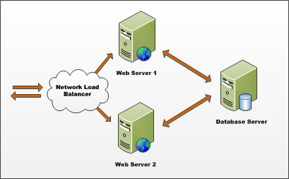
Farms
SharePoint deployment based on farms
Farm requires Web server(s) and database server
Farm can be single server or multi-server
Each farm has exactly one configuration database
Single-server farm used for development environments
Notes:
A SharePoint Farm is simply a collection of servers that have SharePoint installed on them and are all connected to the same configuration database (aka: the config DB).

Slide 10
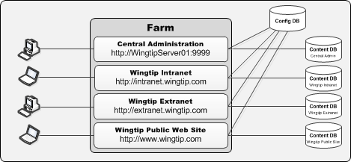
Web Applications
Web Applications provide HTTP entry points
Web Applications based on IIS Web sites
Web Application defines one or more URL spaces
Web Application security configured independently
Notes:
SharePoint sites and content live within SQL Server databases called “content databases”. SharePoint is primarily a Web-based application. Microsoft uses Web applications, also referred to as Web Sites in Internet Information Services (IIS), as the HTTP/HTTP entry point into SharePoint site collections.

Slide 11
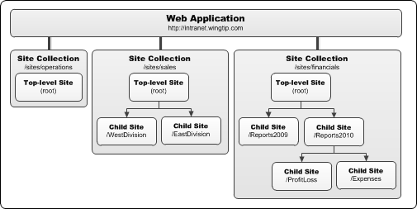
Site Collections and Sites
Sites are partitioned into Site Collections
Site collection is scope for administrative privileges
Site collection always contains top-level site
Site collection may contain hierarchy of child sites
Web application can support 1000s of site collections
Notes:
All content resides in SharePoint sites. These sites contain lists, document libraries and other subsites.
Sites are grouped into site collections. Each site collection must have exactly one site referred to as the “top-level” or “root” site. This site has all the same characteristics of other SharePoint sites.

Slide 12
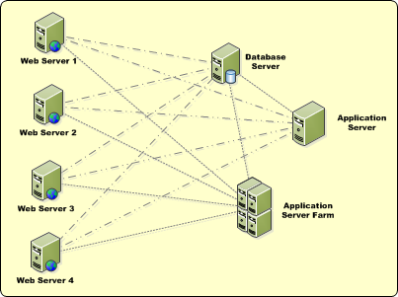
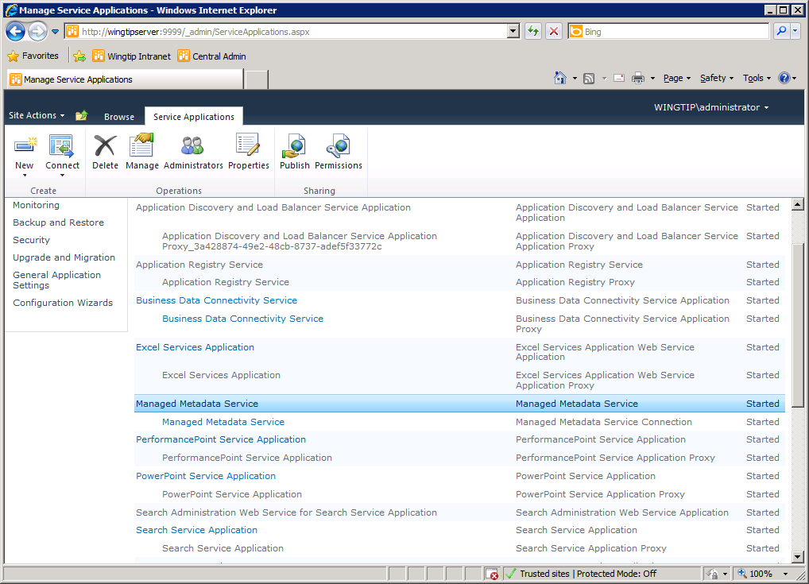
Service Applications
Service applications facilitate resource sharing
This architecture is new in SharePoint Foundation
Replaces Shared Service Providers (SSPs)
Service apps can run on WFE or Application Server
Service apps can be used across farms
administrated through Central Admin
Notes:
Microsoft broke up the Shared Service Provider (SSP) framework in SharePoint 2007 into a new model called Service Applications. This new model facilitates a multitenant deployment of SharePoint 2010 as much more flexible SharePoint farm topologies.
Web applications are no longer tied to a collection of configured service offerings such as in the SSP model. Now Web applications can be associated with different service offerings (service applications) on a more a la carte model.

Slide 13
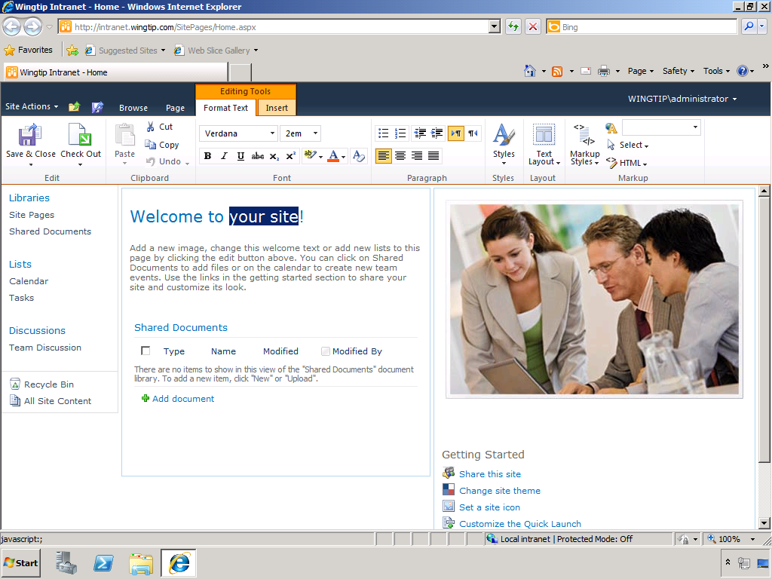
The New SharePoint 2010 Team Site
SharePoint 2010 introduces big changes to UI
Notes:
The SharePoint 2010 Team site looks quite a bit different from SharePoint 2007:
Master page has changed (Site Action menu now on left)
Home Page is a wiki page (SitePages/Home.aspx)
New lists and galleries created behind the scenes
Ribbon

Slide 14
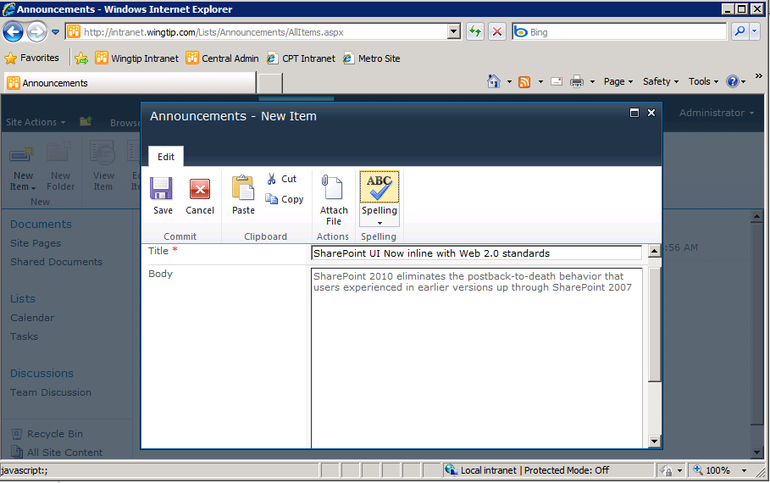
A Much Improved User Experience (UX)
SharePoint 2010 UI designed for Web 2.0 standards
in-place Editing
modal dialogs
far fewer postbacks
Notes:
There has been a major overhaul to the most basic aspects of the SharePoint UI. Many of these changes have been designed to get rid of all the HTTP postbacks that are required when making updates in the browser. SharePoint 2010 has a new core engine for processing pages based on ASP.NET AJAX and designed to deliver a more of a Web 2.0 user experience.
SharePoint 2010 adds a new server-side ribbon to create a consistency with the client-side ribbon added to Office applications with the release of the Office 2007 system. The ribbon now provides a JavaScript-enabled paradigm where the user can move between modes (e.g. edit mode versus display mode) without sending postbacks to the Web server. In-place editing is the most obvious change that users will notice when moving from SharePoint 2007.

Slide 15
DEMO
Creating and Customizing a new
SharePoint 2010 Team Site

Slide 16
Agenda
Introductions
SharePoint 2010 Architecture
SharePoint Developer’s Windows PowerShell Primer
SharePoint Designer 2010

Slide 17

Windows PowerShell Support
Previous version of WSS relies on STSADM.EXE
Used for command line administration and scripting
SharePoint 2010 adds support for Windows PowerShell
Windows PowerShell support effectively replaces STSADM.EXE
SharePoint admins & devs must learn Windows PowerShell basics
You can write powerful scripts against SharePoint OM
You can develop custom Windows PowerShell snap-ins
STSADM.EXE
We’ll miss you old friend
Notes:
The previous version of SharePoint relies on STSADM.EXE. This command line utility is still there in SharePoint 2010 but it is strongly advised to use the Windows PowerShell scripts that come with SharePoint 2010.
Windows PowerShell is a command line utility that builds on top of the .NET Framework. You can execute commands at the command line, but you can also write powerful scripts to execute support tasks for SharePoint.
Windows PowerShell is an extensible scripting language and allows you to develop your own custom Windows PowerShell snap-ins. These snap-ins can be developed using tools like Visual Studio and using languages like C# and VB.NET.

Slide 18
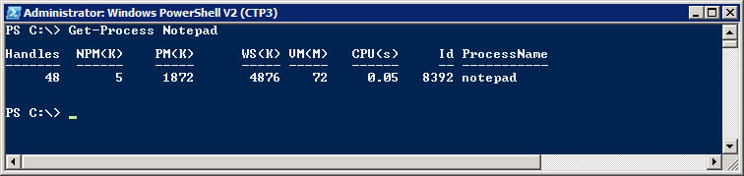
Windows PowerShell Primer for Beginners
What is Windows PowerShell?
A modern replacement for the CMD (command) shell
A powerful scripting environment for administration
Windows PowerShell fundamentals
Cmdlets (e.g. Get-Process and Stop-Process)
Pipelining and formatting features
Provider-based model for accessing resources
Notes:
Over the last few years, Windows PowerShell scripting has begun to replace older DOS-style batch files and VBScript files as the preferred way to manage and automate administrative tasks
Cmdlets are callable functions.
Pipelining allows one Cmdlet to return an object as input to another.
Windows PowerShell includes formatting features to display output using lists or tables.
Windows PowerShell is based on a provider-based model based on Snap-ins.
SharePoint support is added through Microsoft.SharePoint.Powershell.dll

Slide 19
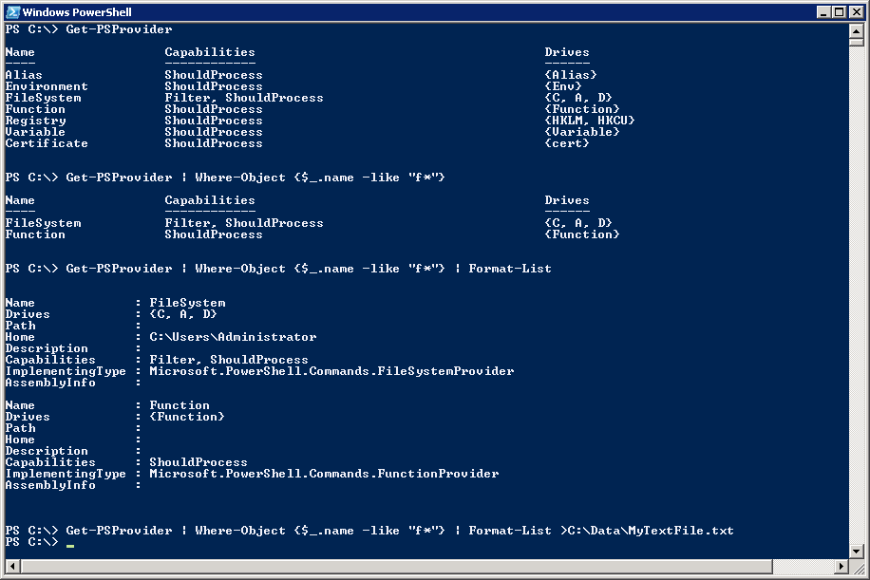
Getting Started with Windows PowerShell
(1) Execute a Cmdlet
(2) Filter results using where clause
(3) Add formatting instructions
(4) Redirect output to new text file
Notes:
The first example shows calling a Cmdlet that takes no parameters.
The second example adds filtering by adding a Where command:
Where-Object {$_.name –eq "F*"}
The syntax $_ refers to the object in question
$_.name refers to the object's name property
-eq is the operator for equals
The third example adds in formatting instructions.
The last example redirects output so it is stored in a new text file.

Slide 20
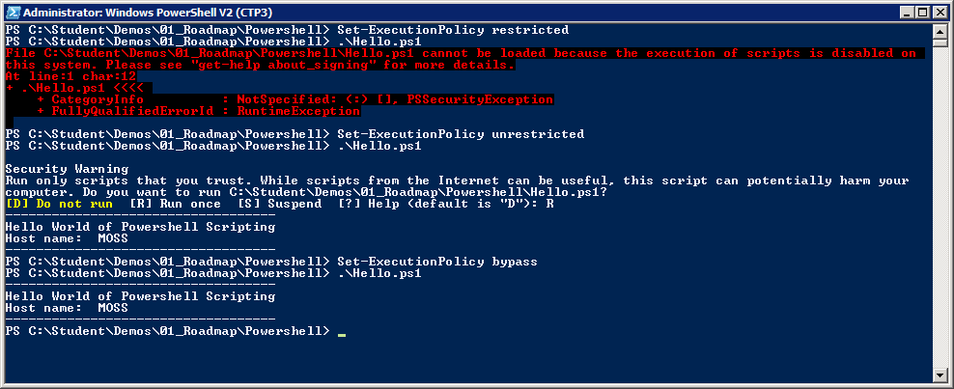
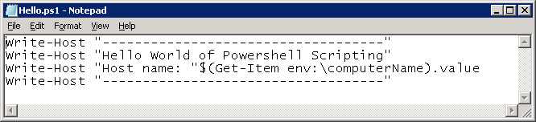
Scripts and Execution Policy
You can author Windows PowerShell scripts
Scripts have *.ps1 extension
Local execution policy must be configured
Scripts will not execute under default execution policy of restricted
Scripts can execute under execution policy of unrestricted. Scripts that are not signed result in prompting user for permission to execute.
Scripts can execute under execution policy of bypass. This mode suppresses prompting user for permission to execute.
Notes:
By default, Windows PowerShell does not allow script to run. The SharePoint Administrator must change execution policy to enable script execution.
There are a number of settings that you can apply to Execution Policy:
restricted (default) – Scripts prohibited from executing.
unrestricted - Scripts can execute. Scripts that are signed can run with user interaction. Scripts that are not signed result in prompting user for permission to execute.
bypass (developer mode) – Scripts can execute and user interaction is suppressed.

Slide 21
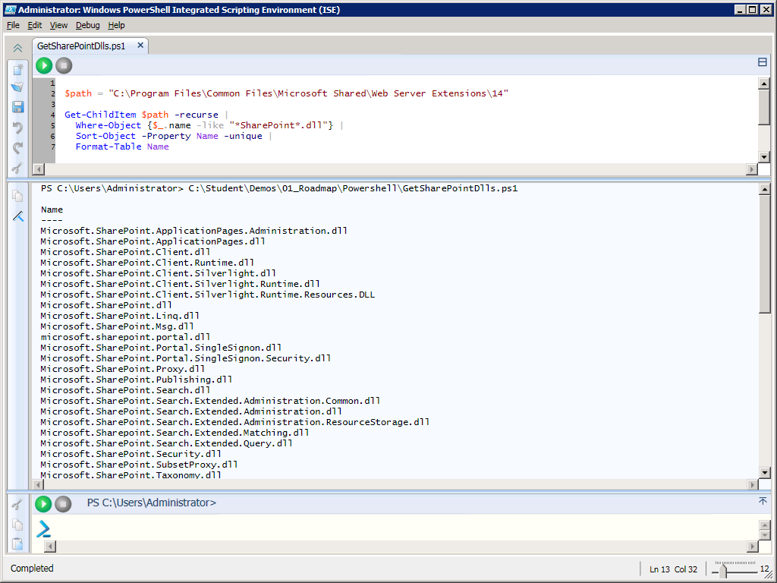
Editing Scripts with Windows PowerShell ISE
Supports color-coding, IntelliSense and debugging
Notes:
With the initial release of Windows Powershell, administrators and developers usually resorted to writing scripts with NotePad. Windows PowerShell 2 provides a nice development environment for writing Windows PowerShell scripts named the Windows PowerShell Integrated Scripting Environment (ISE).
When it comes to writing complex scripts with control of flow logic, it is really nice to be able to debug and single step through your code.

Slide 22
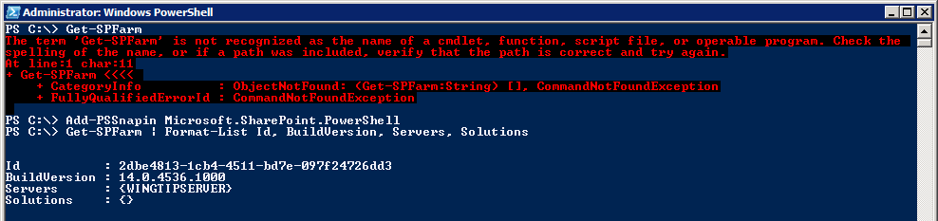
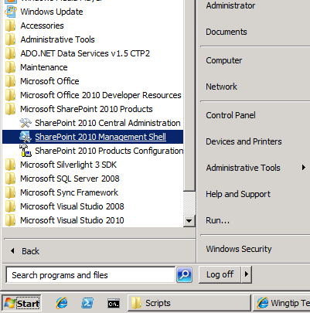
SharePoint Windows Powershell Snapin
Explicitly load SharePoint Windows PowerShell snap-in from console or script
Implicitly load snap-in by using link in Windows Start menu
Begin using SharePoint Cmdlets
Notes:
SharePoint Server 2010 adds many Cmdlets for SharePoint administration through a Snap-in provider named Microsoft.SharePoint.PowerShell. The SharePoint cmdlets cannot be called until the SharePoint snap-in has been loaded.
There are two common ways to load the SharePoint snap-in:
Call the Add-PSSnapincmdlet and pass a parameter with the snap-in name
Launch the Windows PowerShell console using SharePoint 2010 Management Console. This link points to an XML file that loads the SharePoint snap-in in a declarative fashion.

Slide 23
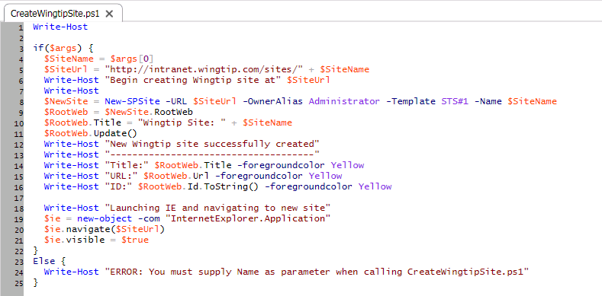
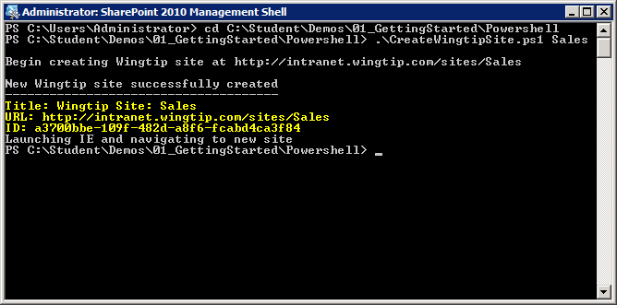
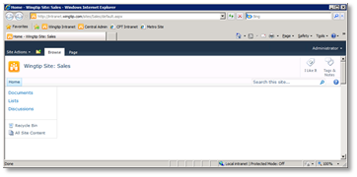
Examples of SharePoint Scripting
Notes:
The first example shows how to get a farm-wide list of all features that have been installed with a Display Name that contains the word "Publishing". This example also shows how to use Windows PowerShell fundamentals for filtering, sorting and formatting.
The second example shows a Windows PowerShell script which uses the New-SPSite cmdletto create a new site. You should observe that the New-SPSite cmdlet returns a SPSite object which is then used to access the SPWeb object for the top-level site.

Slide 24
DEMO
Writing PowerShell Scripts for SharePoint

Slide 25
Agenda
Introductions
SharePoint 2010 Architecture
SharePoint Developer’s Windows PowerShell Primer
SharePoint Designer 2010

Slide 26
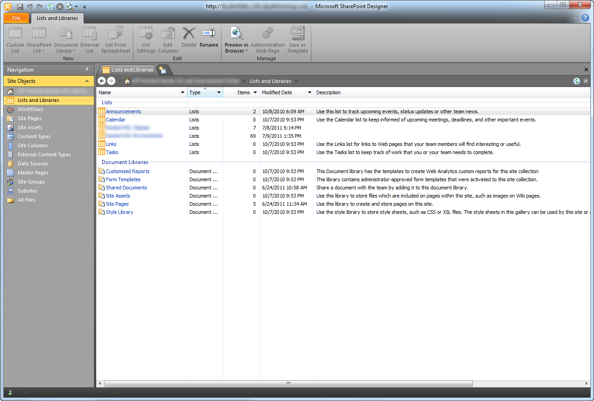
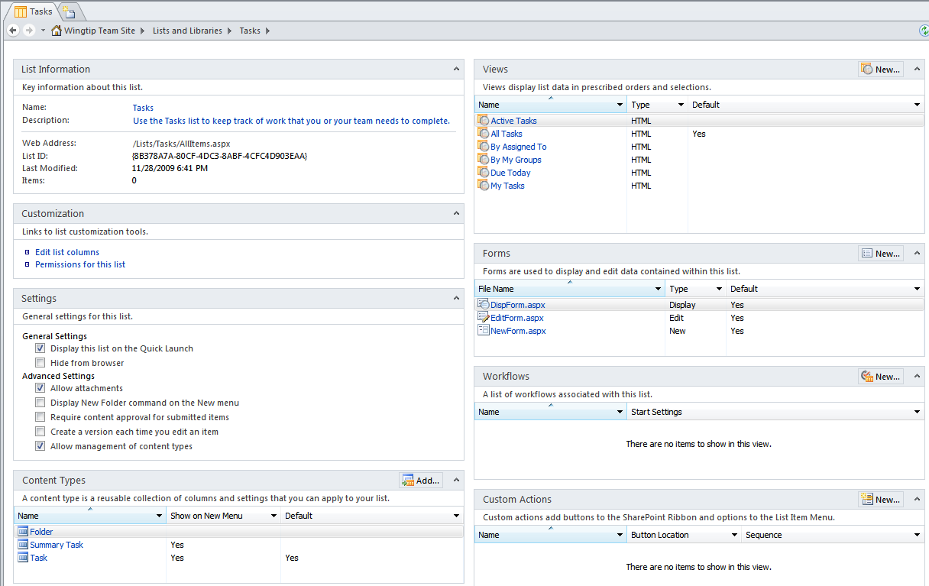
SharePoint Designer 2010 (SPD)
SPD 2010 designed around SharePoint objects
Each SharePoint object has summary page
SharePoint object can have collections of child objects
New user experience makes navigation more intuitive
Child Object
Collections
Notes:
SharePoint Designer 2010 is designed around SharePoint objects. Each SharePoint object has a summary page that gives you access to the different properties and collections of child objects.
The commands that can be executed on the SharePoint objects are grouped in a contextual ribbon.
The new user experience makes navigation more intuitive.

Slide 27
DEMO
Making Site Customizations with SharePoint Designer 2010

Slide 28
Summary
Introductions
SharePoint 2010 Architecture
SharePoint Developer’s Windows PowerShell Primer
SharePoint Designer 2010

